Slide 1
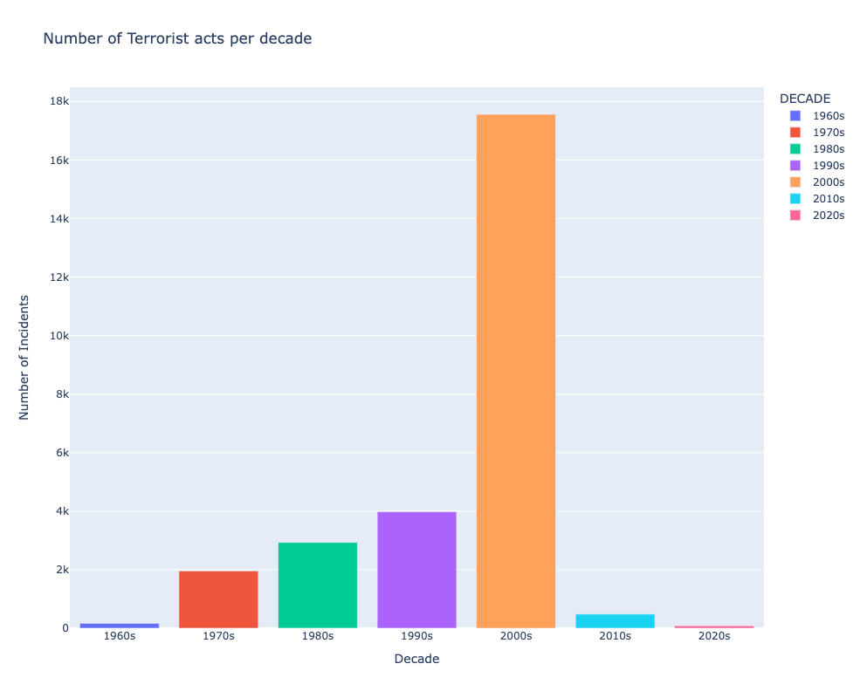

Slide 2
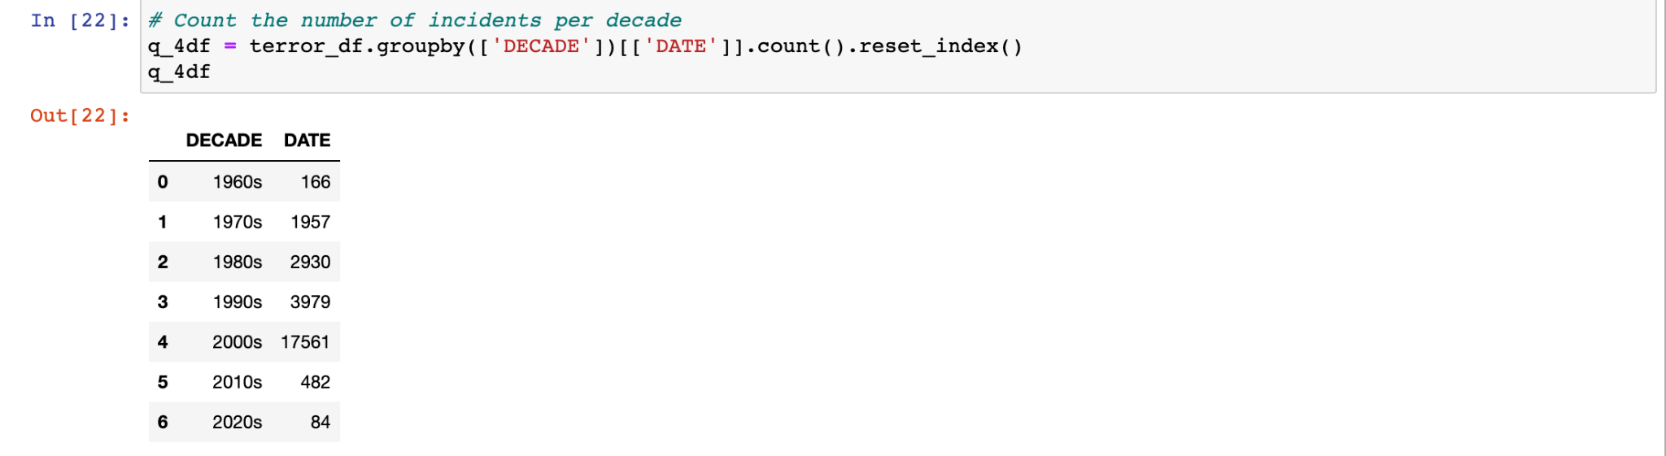
Decades with the most Terrorist acts from 1968 - 2022

Slide 4
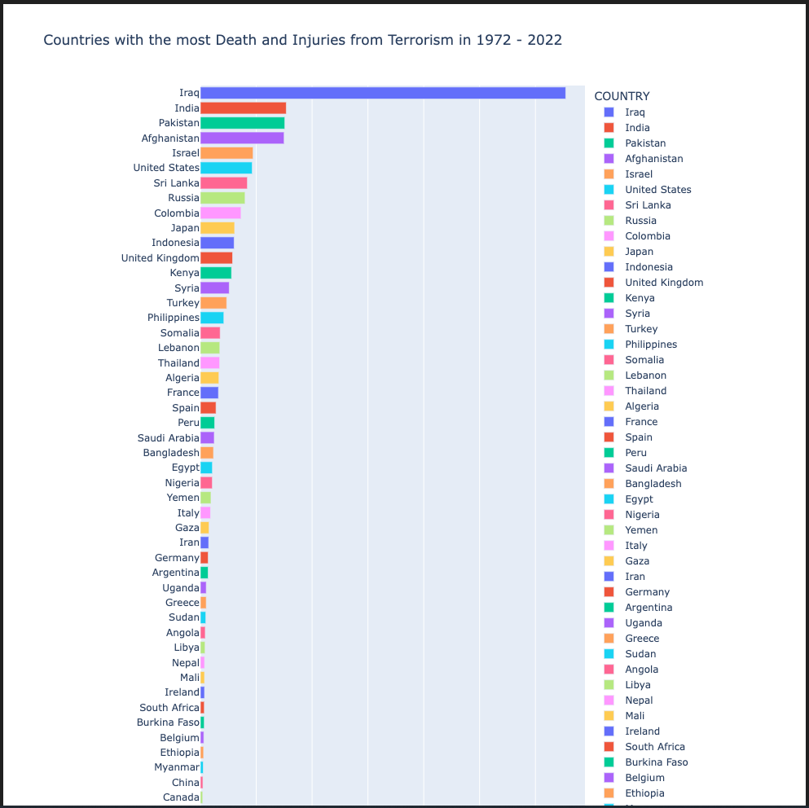

Slide 5
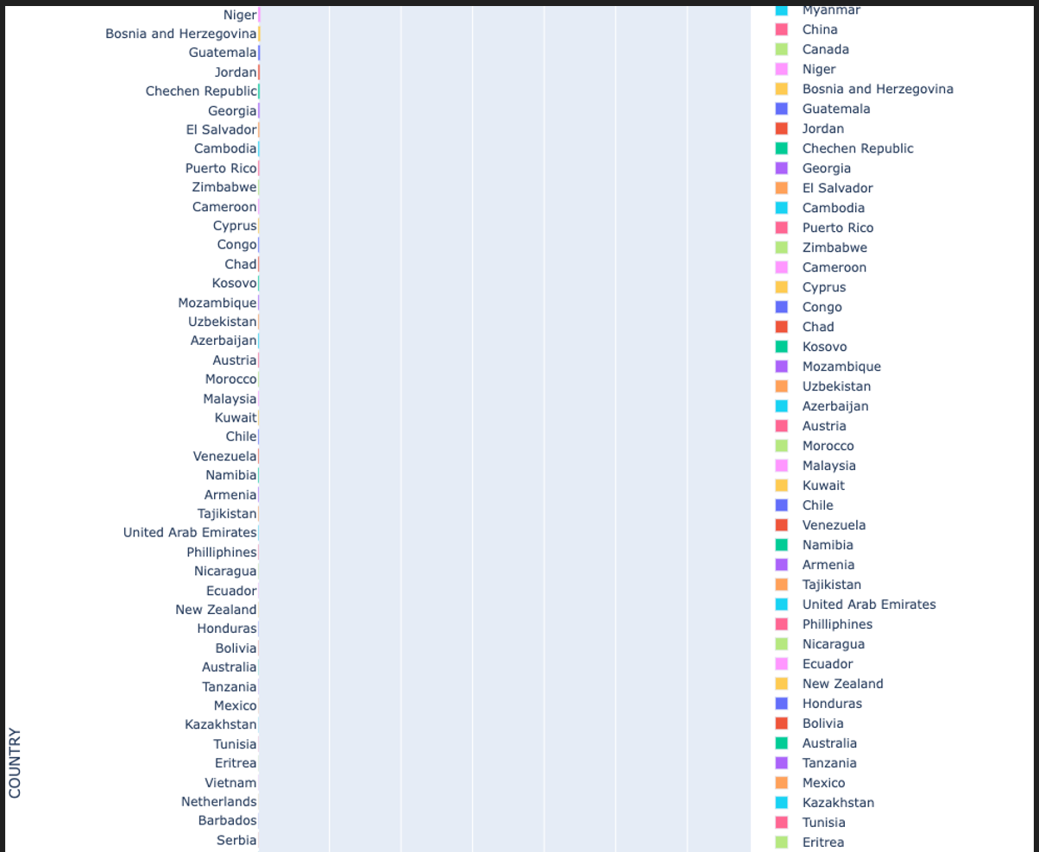
Countries with the most Death and Injuries from Terrorism in 1972 - 2022 Cont’d

Slide 6
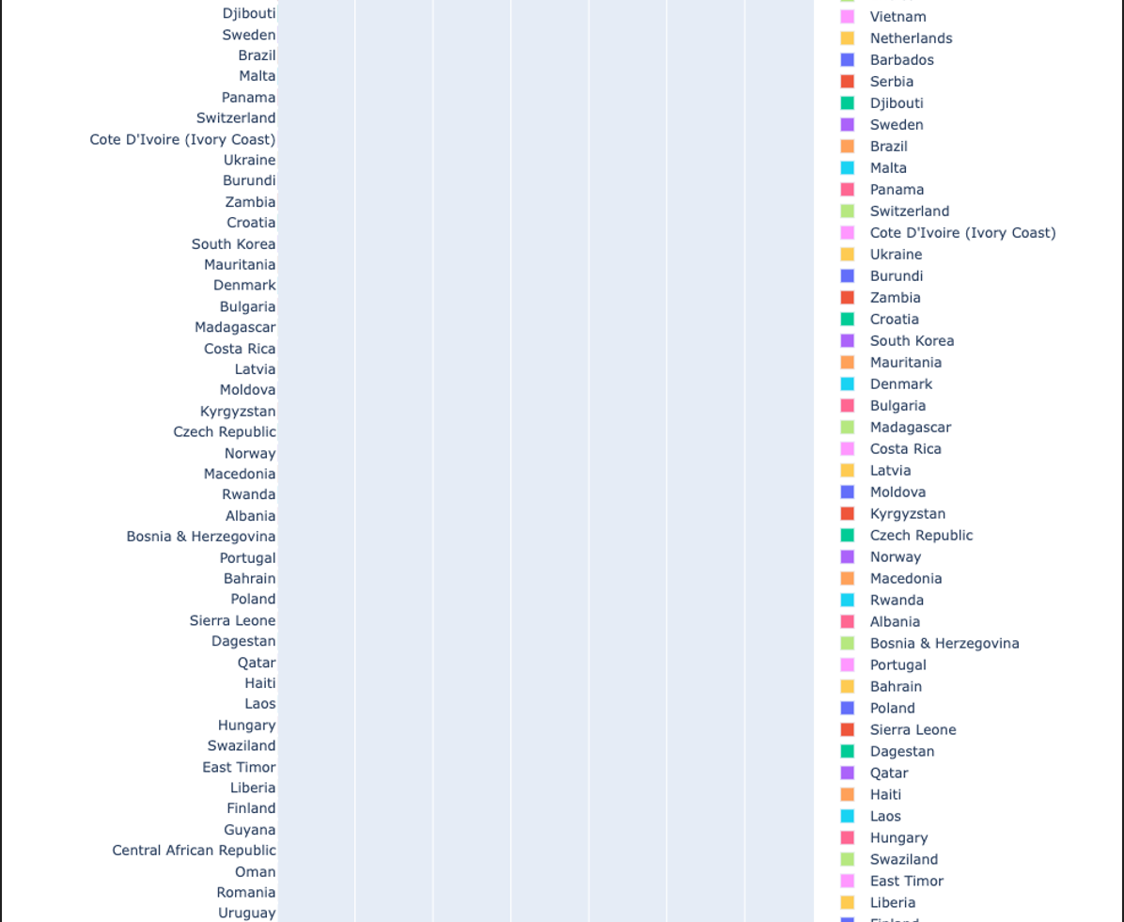
Countries with the most Death and Injuries from Terrorism in 1972 - 2022 Cont’d

Slide 7
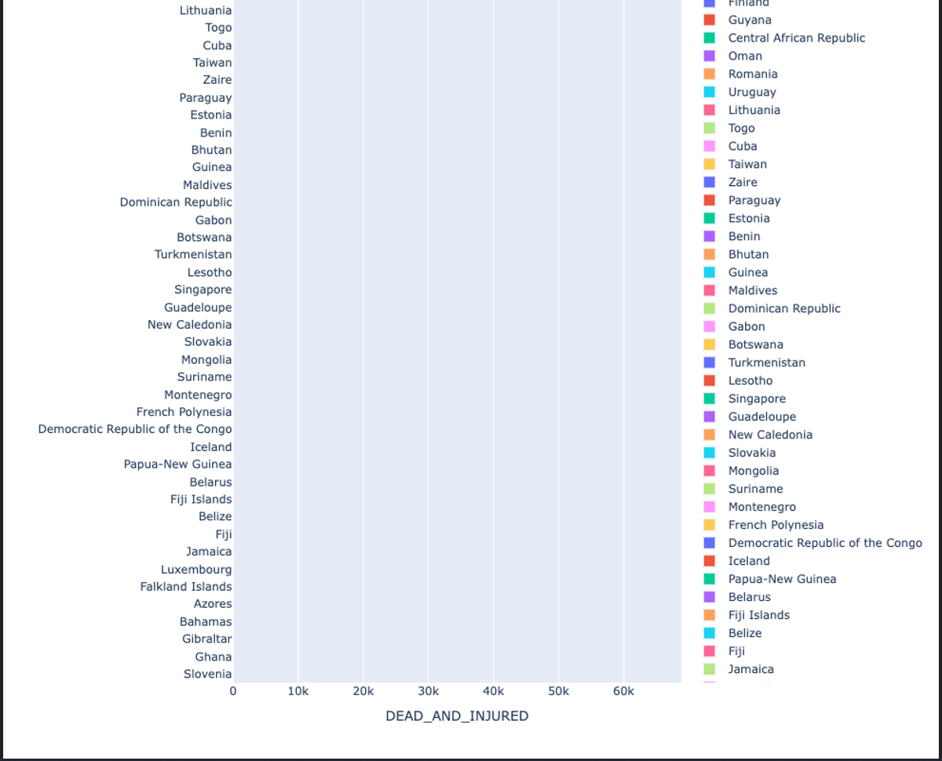
Countries with the most Death and Injuries from Terrorism in 1972 - 2022 Cont’d

Slide 8
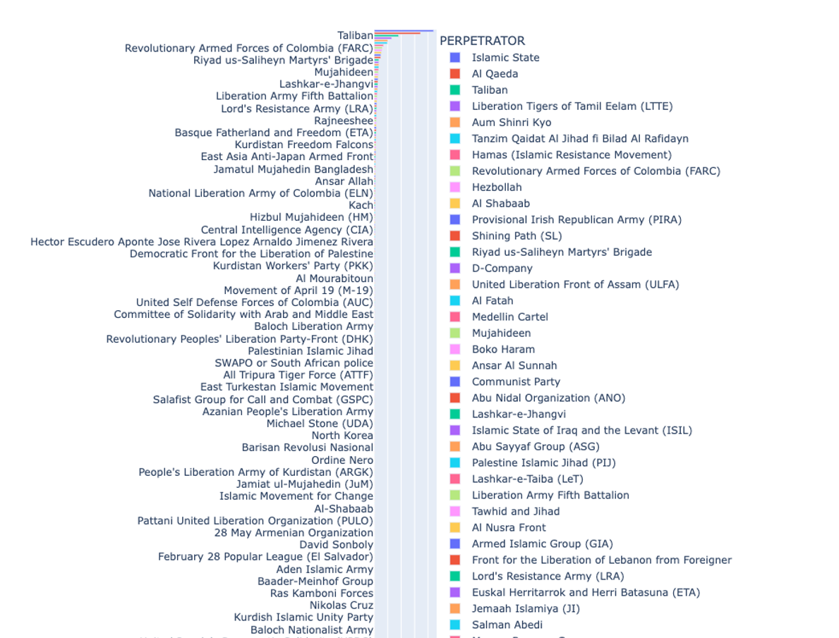
Top Terrorist Groups

Slide 9
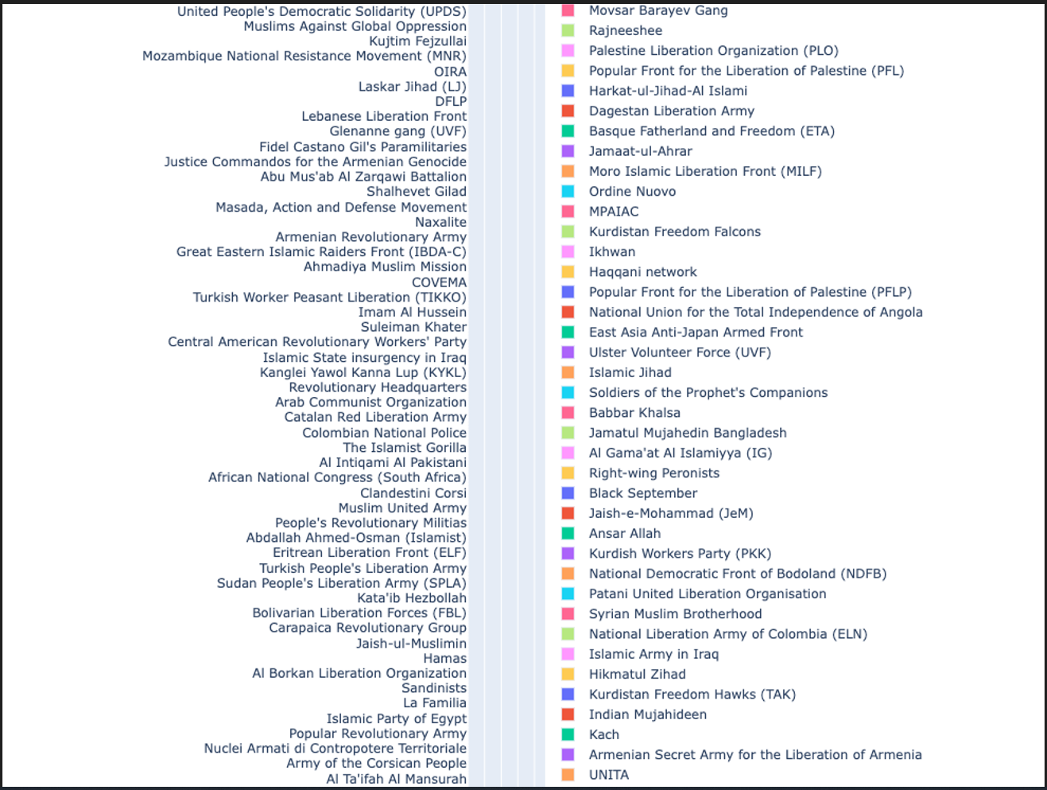
Top Terrorist Groupd Cont’d

Slide 10
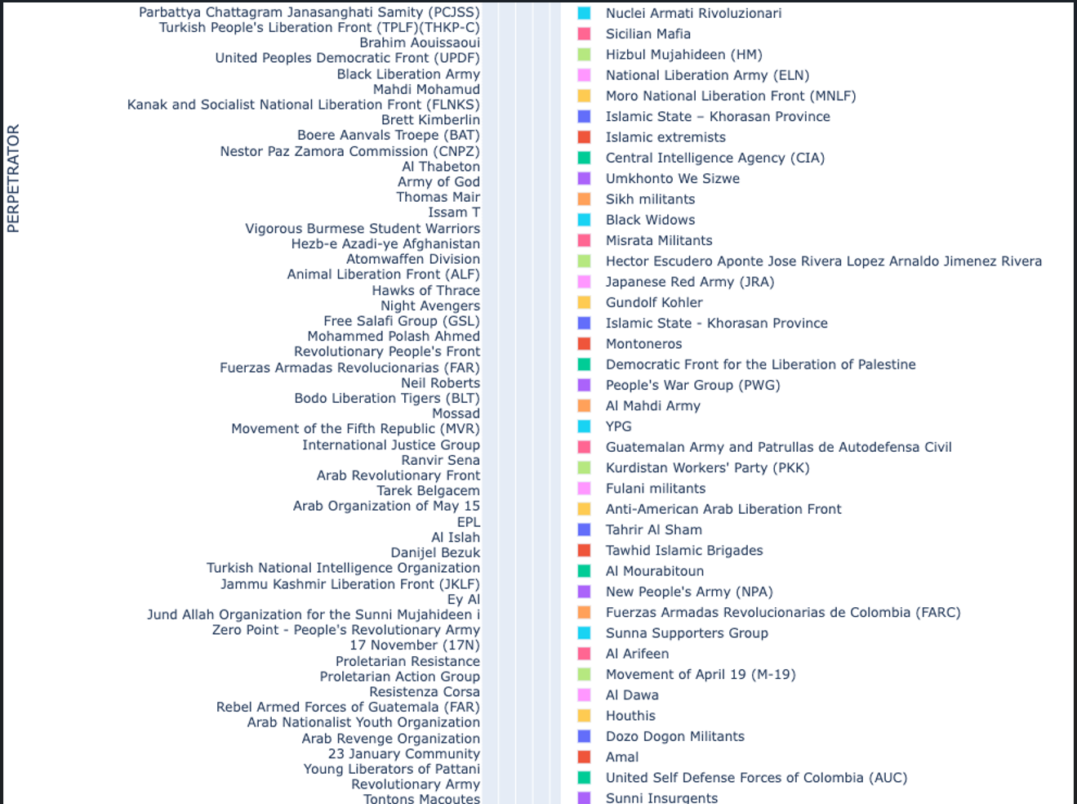
Top Terrorist Groups Cont’d

Slide 11
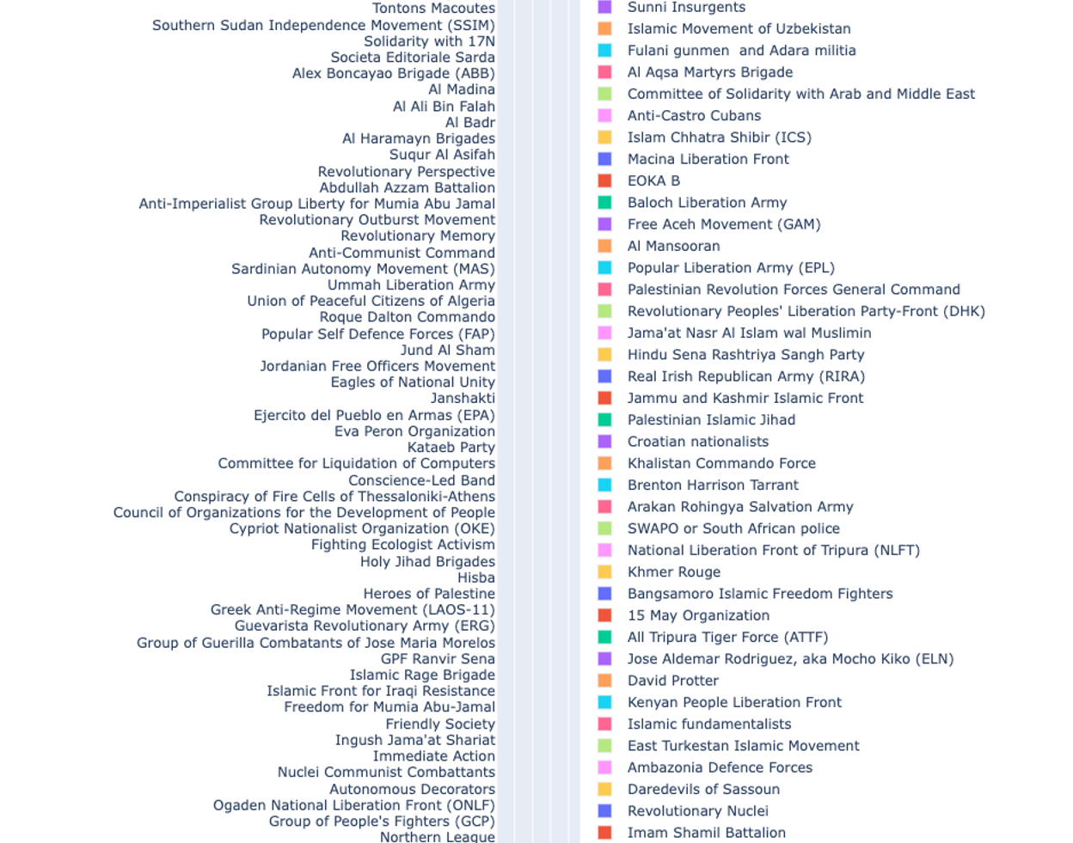
Top Terrorist Groups Cont’d

Slide 12
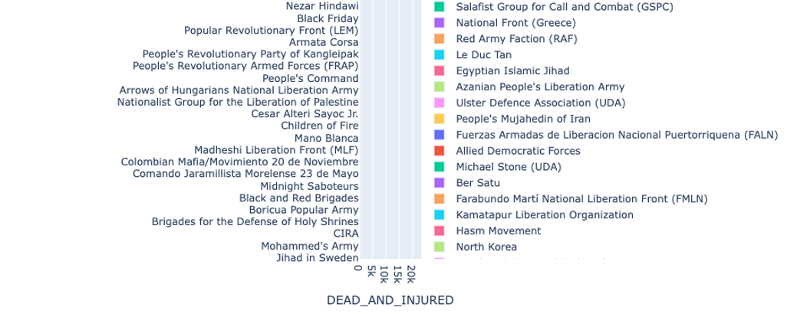
Top Terrorists Groups Cont’d

